Slide 1

K-12 Microelectronic Workshop Arduino Programming
1 struct instructor {
2 String name = “Yi Liu”;
3 String department = “Mechanical Engineering”;
4 String university = “University of Vermont”;
5 }

Slide 2
Contents
2. First Arduino Program
2.1 Arduino sketch structure
2.2 Uploading
2.3 Using delay — a blinking LED
2.4 Debugging with Serial
2.5 Summary

Slide 3
2.1 First Arduino program
0_BasicStructure.ino
1 void setup() {
2 // put your setup code here, to run once:
3 }
4
5 void loop() {
6 // put your main code here, to run repeatedly:
7 }

Slide 4
2.1 First Arduino program
1 void setup() {
2 // put your setup code here, to run once:
3 }
initializes configurations
sets pin modes
starts serial communications
only execute once

Slide 5
2.1 First Arduino program
5 void loop() {
6 // put your main code here, to run repeatedly:
7 }
called immediately after setup()
runs repeatedly

Slide 6

2.1 First Arduino program
1_LightUpLED.ino
const int ledPin = 13;
2
3 void setup() {
4 pinMode(ledPin, OUTPUT);
5 }
6
7 void loop() {
8 digitalWrite(ledPin, HIGH);
9 }

Slide 7
2.1 First Arduino program
1 const int ledPin = 13;
declare constant integer value ledPin
assign 13 to ledPin

Slide 8
2.1 First Arduino program
1_LightUpLED.ino
4 pinMode(ledPin, OUTPUT);
set ledPin to OUTPUT mode

Slide 9

2.1 First Arduino program
Syntax:
pinMode(pin, mode);
pin: int, the pin number you want to configure
mode: the mode of operation of the pin.
INPUT: set the pin to input mode
OUTPUT: set the pin to output mode
returns: void

Slide 10
2.1 First Arduino program
8 digitalWrite(ledPin, HIGH);
send 5V (or 3.3V on 3.3V board) to ledPin

Slide 11
2.1 First Arduino program
Syntax:
digitalWrite(pin, mode);
pin: int, the pin number you want to write the value
mode: the mode of operation of the pin.
HIGH: set the pin to high voltage level
LOW: set the pin to low voltage level
returns: void

Slide 12
Contents
2. First Arduino Program
2.1 Arduino sketch structure
2.2 Uploading
2.3 Using delay — a blinking LED
2.4 Debugging with Serial
2.5 Summary

Slide 13
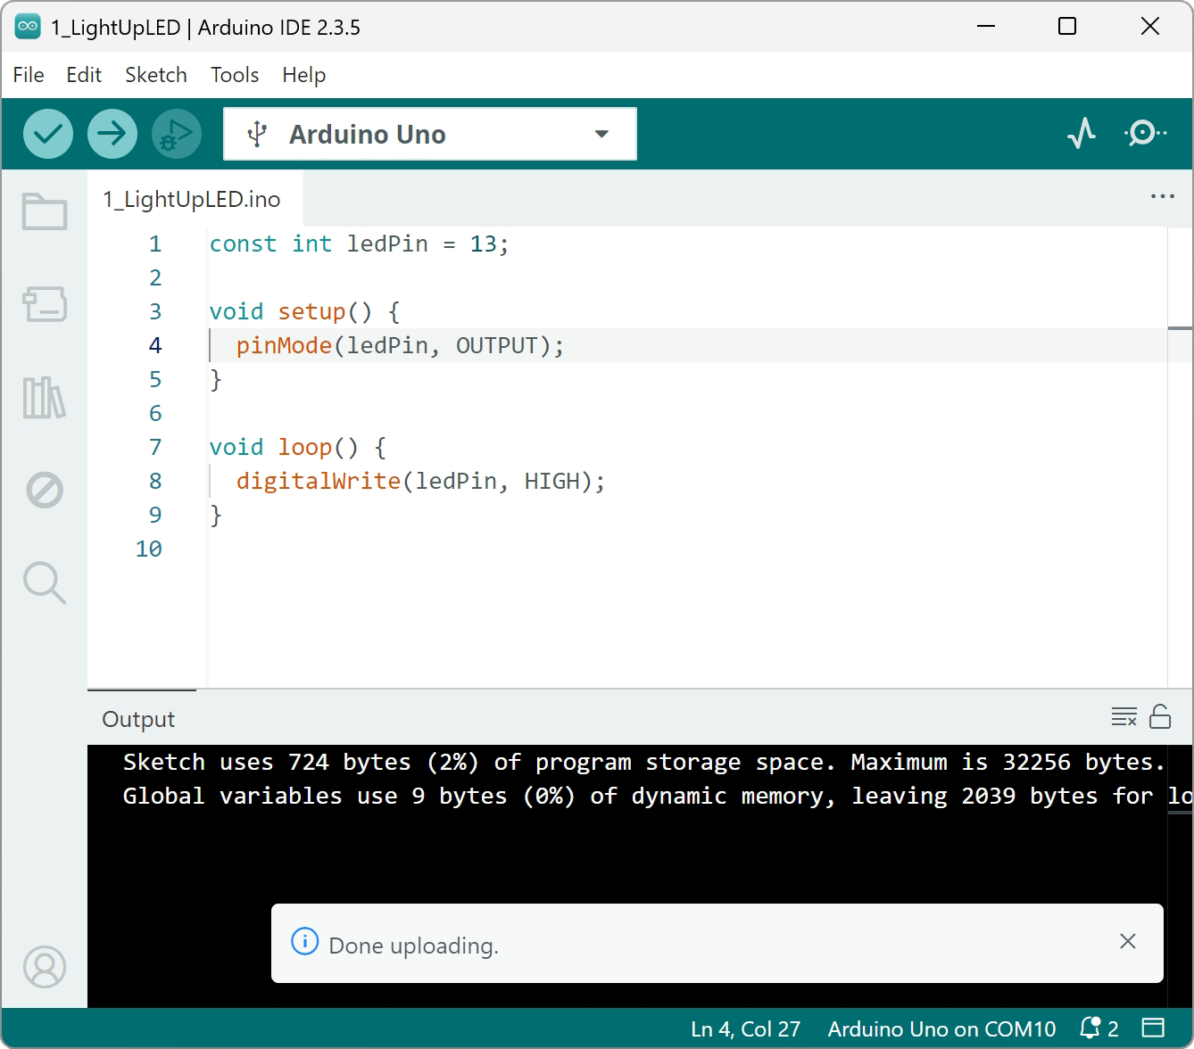
2.2 Uploading
select correct board
click verify
click upload

Slide 14
Contents
2. First Arduino Program
2.1 Arduino sketch structure
2.2 Uploading
2.3 Using delay — a blinking LED
2.4 Debugging with Serial
2.5 Summary

Slide 15
2.3 Using delay — a blinking LED
2_BlinkLED.ino
1 const int ledPin = 13;
2
3 void setup() {
4 pinMode(ledPin, OUTPUT);
5 }
6
7 void loop() {
8 digitalWrite(ledPin, HIGH);
9 delay(1000);
10
11 digitalWrite(ledPin, LOW);
12 delay(1000);
}

Slide 16
2.3 Using delay — a blinking LED
9 delay(1000);
pauses the program for a specific amount of time
in milliseconds

Slide 17
2.3 Using delay — a blinking LED
Syntax:
delay(milliseconds);
milliseconds: int, time (in milliseconds) to pause
1000 milliseconds = 1 second
returns: void

Slide 18
Contents
2. First Arduino Program
2.1 Arduino sketch structure
2.2 Uploading
2.3 Using delay — a blinking LED
2.4 Debugging with Serial
2.5 Summary

Slide 19
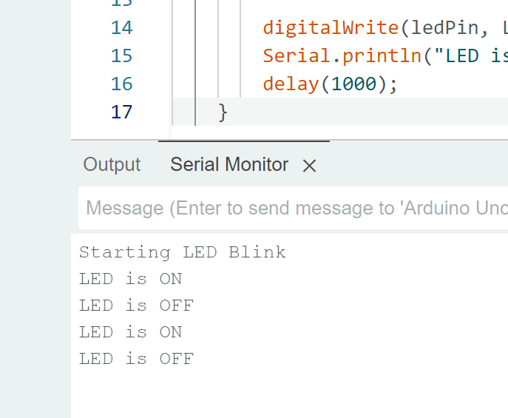
2.4 Debugging with Serial
Serial Monitor can display real-time textual data from Arduino board
is a good way to output
variables
parameters
states

Slide 20
2.4 Debugging with Serial
3_SerialPrint_BlinkLED.ino — setup()
1 const int ledPin = 13;
2
3 void setup() {
4 pinMode(ledPin, OUTPUT);
5 Serial.begin(9600);
6 Serial.print(“Starting LED Blink on pin ”);
7 Serial.println(ledPin);
8 }

Slide 21
2.4 Debugging with Serial
5 Serial.begin(9600);
start serial communication between the Arduino board and the computer
sets the data rate in bits per second

Slide 22
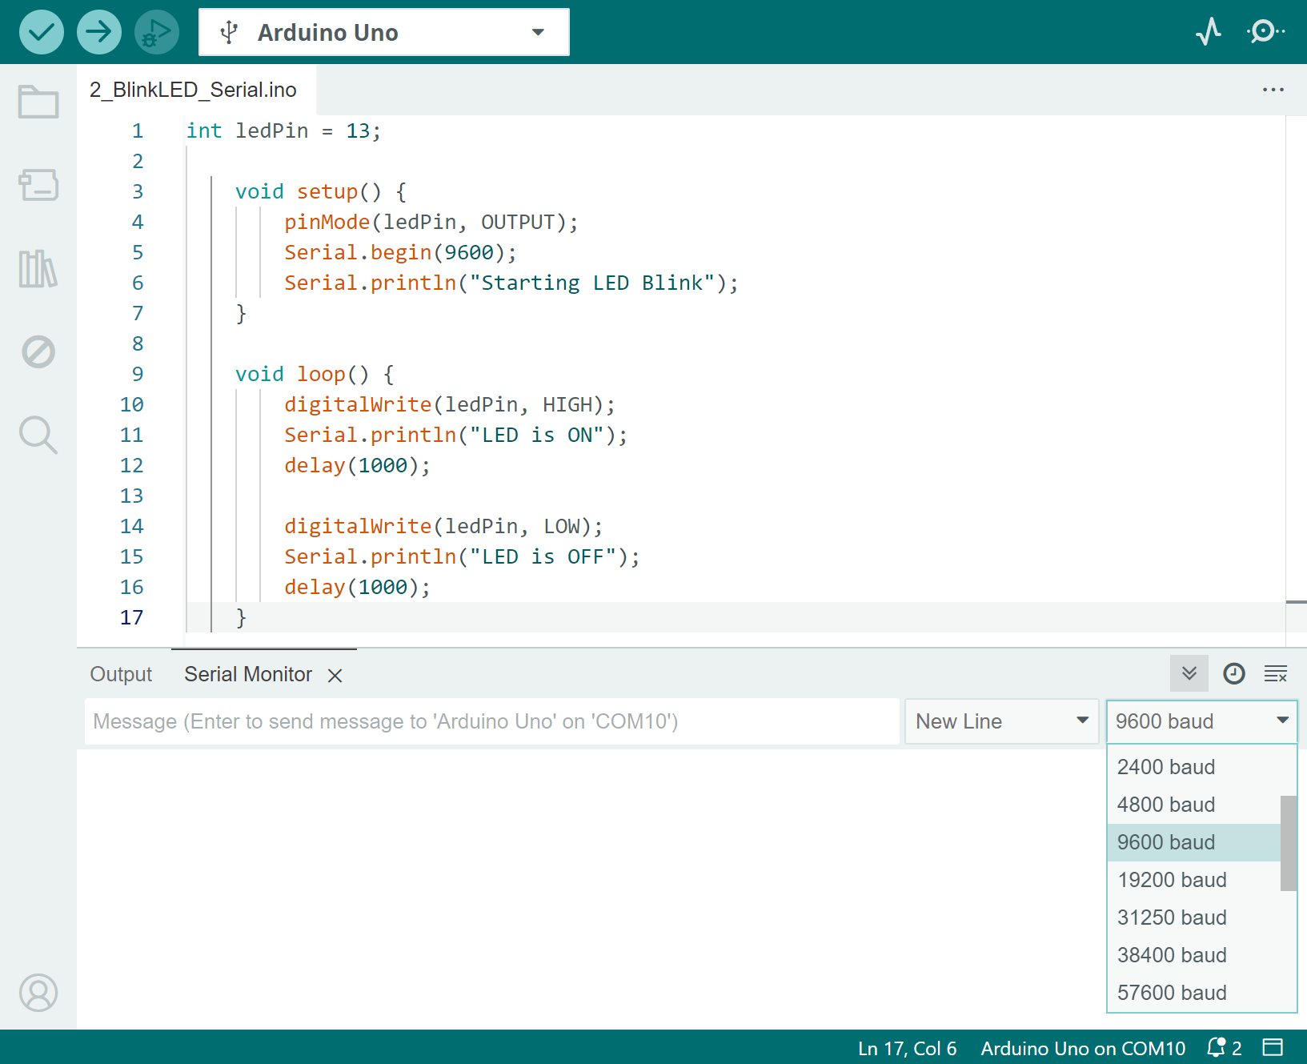
2.4 Debugging with Serial
Syntax:
Serial.begin(speed);
speed: int, it refers to baud rate and defines how quickly data is sent and received between devices.
the common value is 9600
115200 for large amounts of sensor data
more options can be found in Serial Monitor after the board is connected
returns: void

Slide 23
2.4 Debugging with Serial
6 Serial.print(“Starting LED Blink on pin ”);
7 Serial.println(ledPin);
send data to the Serial Monitor via serial

Slide 24
2.4 Debugging with Serial
Syntax:
Serial.print(value)
Serial.println(value)
value: can be any type of data
int
float
long
char
…
Serial.println() adds “\n” at the end
next printed data will appear on a new line

Slide 25
2.4 Debugging with Serial
3_SerialPrint_BlinkLED.ino — loop()
10 void loop() {
11 digitalWrite(ledPin, HIGH);
12 Serial.println(“LED is ON”);
13 delay(1000);
14
15 digitalWrite(ledPin, LOW);
16 Serial.println(“LED is OFF”);
17 delay(1000);
18 }

Slide 26
Contents
2. First Arduino Program
2.1 Arduino sketch structure
2.2 Uploading
2.3 Using delay — a blinking LED
2.4 Debugging with Serial
2.5 Summary

Slide 27
2.5 Summary
digital I/O
pinMode(pin, mode)
digitalWrite(pin, value)
time
delay(milliseconds)
communication
Serial.begin(speed)
Serial.print(value)
Serial.println(value)

Slide 28
2.5 Summary
how to structure an Arduino script?

Slide 29
2.5 Summary
how to structure an Arduino sketch?
constant declarations
variable declarations
e.g. pins

Slide 30
2.5 Summary
how to structure an Arduino sketch?
constant declarations
variable declarations
void setup() {
initializations
}
e.g. pins
e.g. pin mode, serial

Slide 31
2.5 Summary
how to structure an Arduino sketch?
constant declarations
variable declarations
void setup() {
initializations
}
void loop() {
main logics
}
e.g. pins
e.g. pin mode, serial

Slide 32
K-12 Microelectronic Workshop Arduino Programming
1 Serial.println(“Thank you!”);

